Slide 1
Angular
Architecture
Lecture 1
By James(Jin) Wang
09/01/2019

Slide 2
Outline
Components and their Templates
Template Syntax including Data binding
Services using Dependency Injection
Routing
HTTP and Data
Observability with RxJS
How Angular Modules help organize code

Slide 3
Big Picture
  Overview:
  Language Choices
  Angular 1’s Impact
  Comparing Concepts from Angular 1 to 2
  Resources

Slide 4
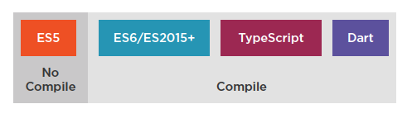
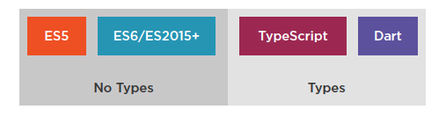
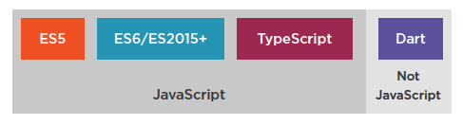
Language Choices

Slide 5
Angular 1 to Angular 2
  7 Key Comparisons:
  Angular Modules
  Controllers to Components
  Structural Built-In Directives
  Data Binding
  Remove the Need for Many Directives
  Services
  Dependency Injection

Slide 6
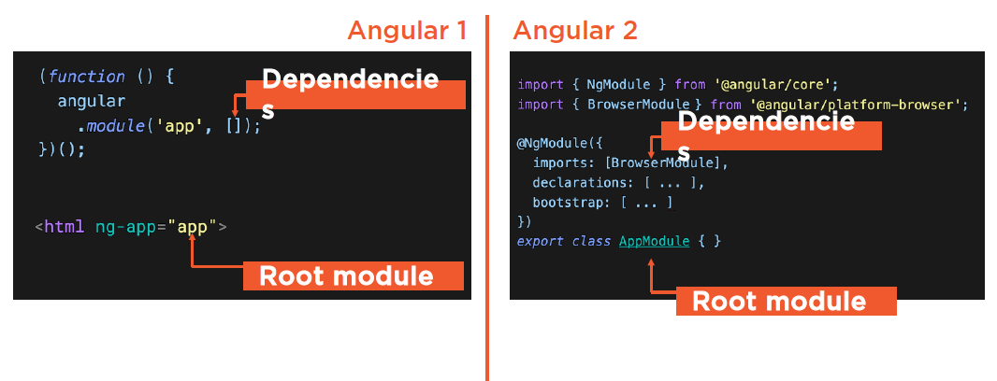
Angular Modules

Slide 7
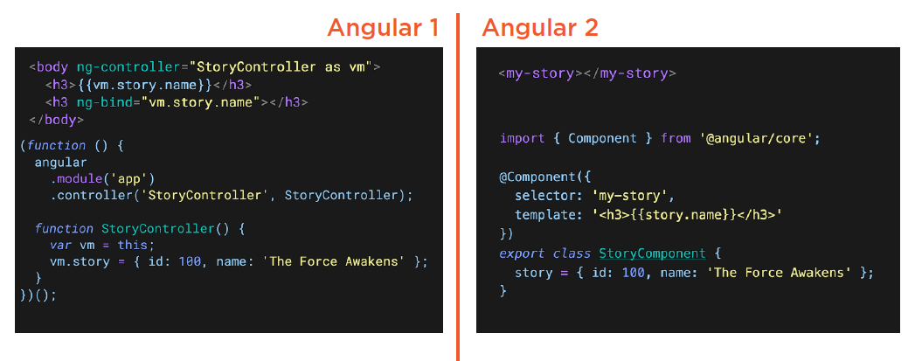
Controllers to Components
  Demo: Controller to Component

Slide 8
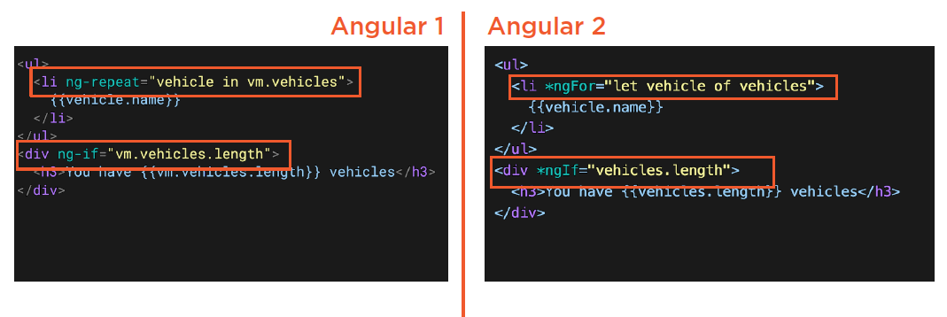
Structural Built-In Directives
  Demo: Structural Directives

Slide 9
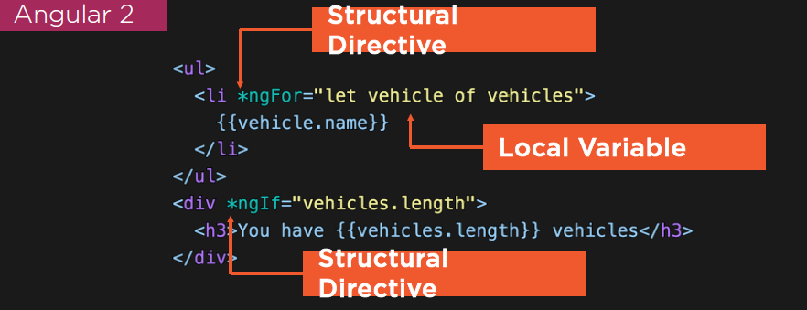
Structural Built-In Directives
  Structural Directives:
  Indicated by the * prefix
  Changes the structure

Slide 10
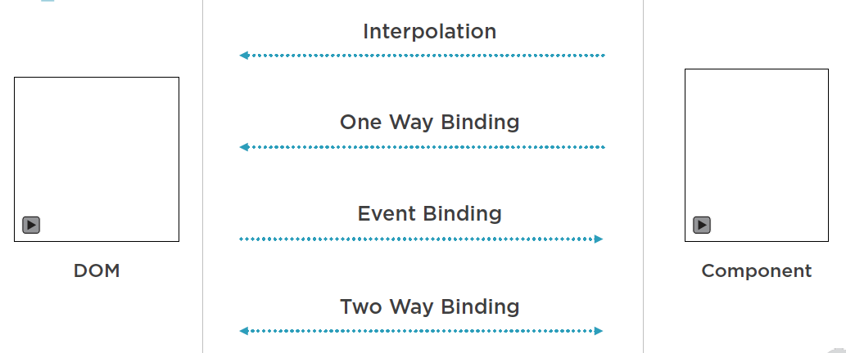
Data Binding

Slide 11
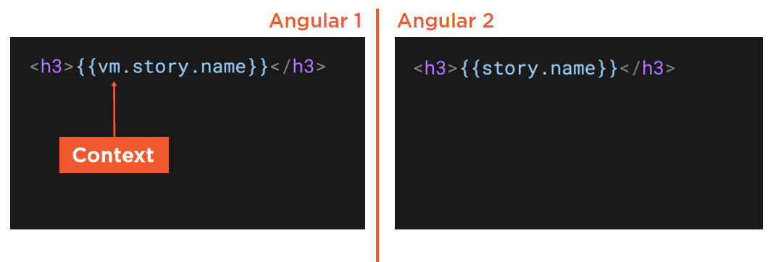
Data Binding
  Interpolation:

Slide 12
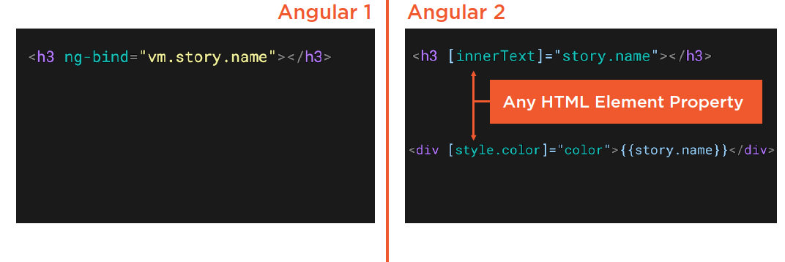
Data Binding
  1 Way Binding:
  Demo: Property Binding

Slide 13
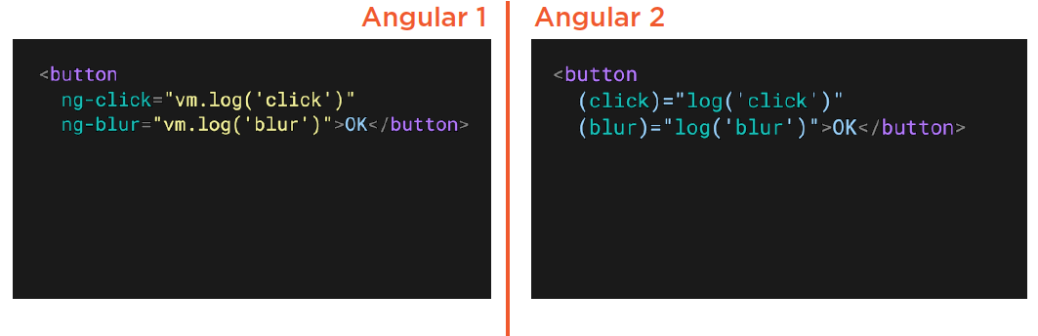
Data Binding
  Event Binding:
  Demo: Event Binding

Slide 14
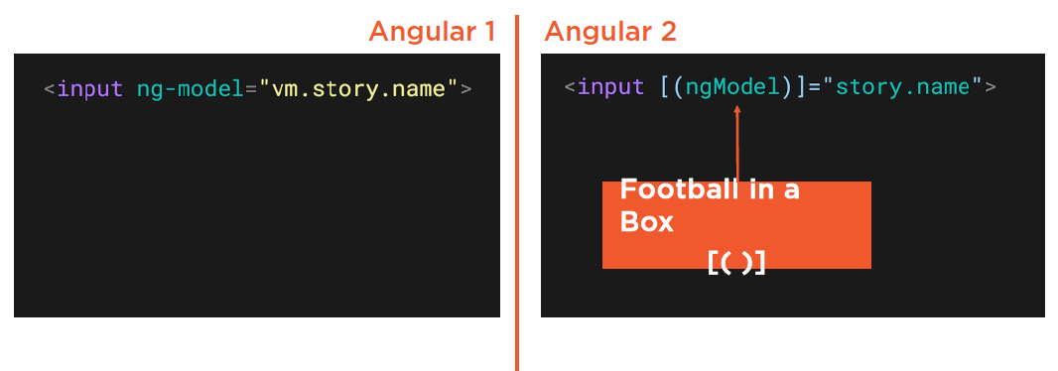
Data Binding
  2 Way Binding on an <INPUT>:
  Demo: 2 Way Data Binding

Slide 15
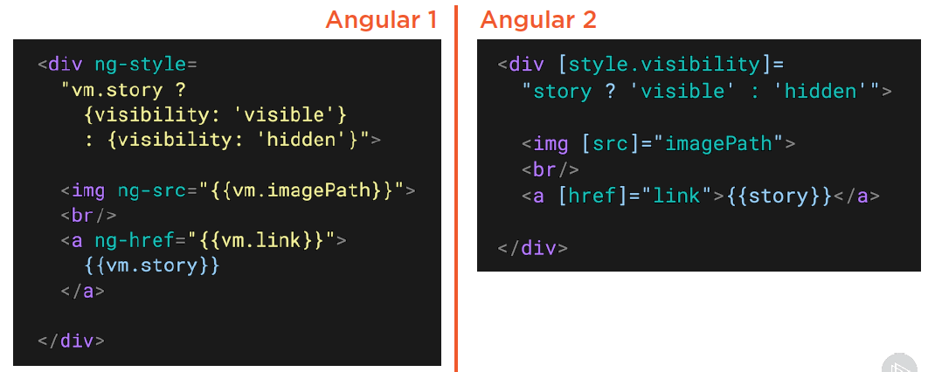
Removes the Need for Many Directives

Slide 16
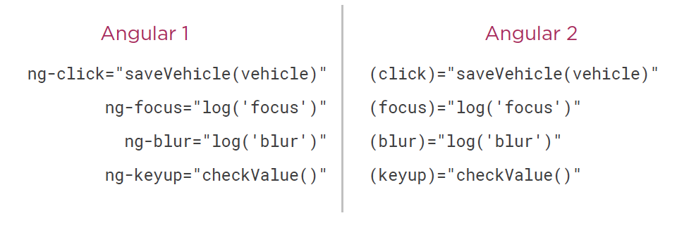
No Longer Need These Directives Either

Slide 17
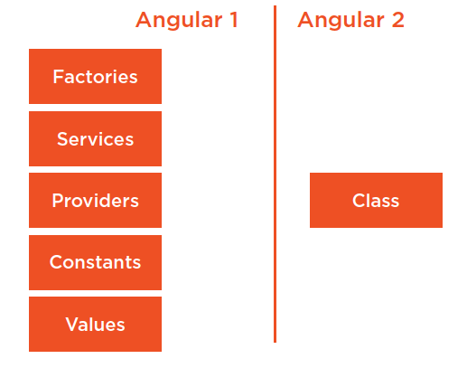
Services

Slide 18
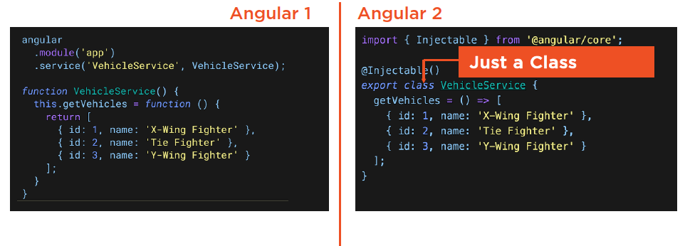
Services
  Creating Services:

Slide 19
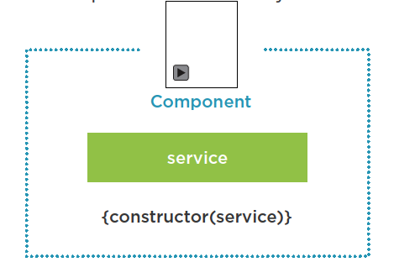
Services
  Dependency Injection:

Slide 20
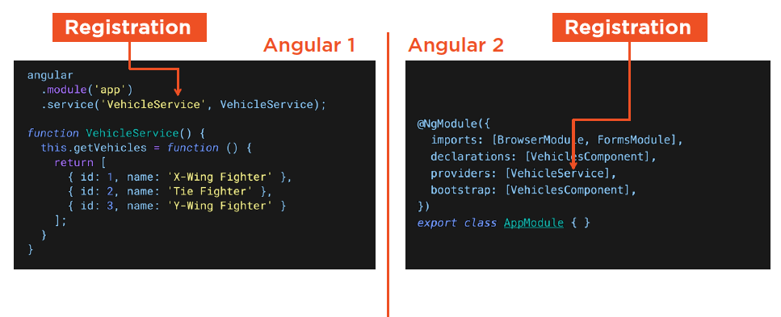
Services
  Registering Services with the Injector:

Slide 21
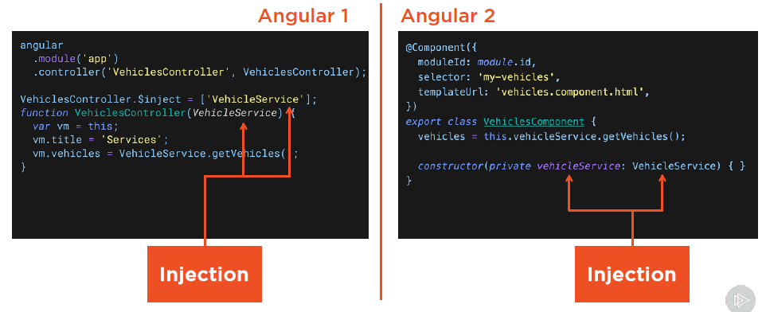
Services
  Dependency Injection:

Slide 22
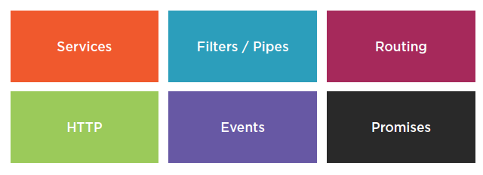
Many Angular 1 Concepts Translate

